Slide 1

BattleShip In Space

Slide 2
HELLO!
SeHoon Min
JungHyun Ryu
JaeHo Jang
YongWon Kim
NaYoung Shin
KyungMin Kim

Slide 3
“ BattleShip ”
Guessing Game.
The game is played on four grids, two for each player.
On one grid the player arranges ships and records the shots by the opponent.

Slide 4
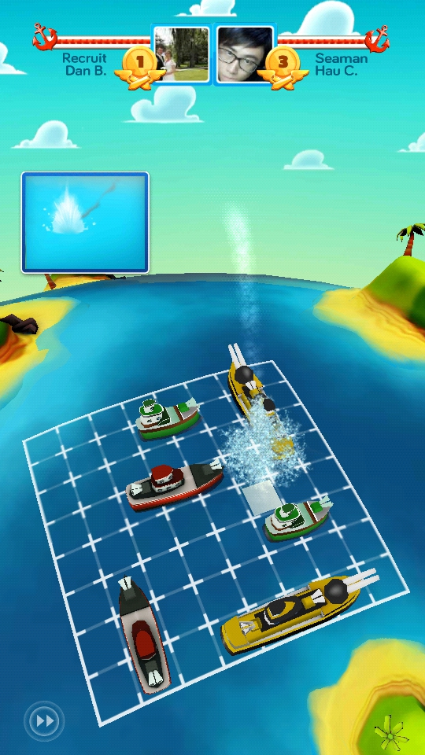
iPhone PROJECT

Slide 5
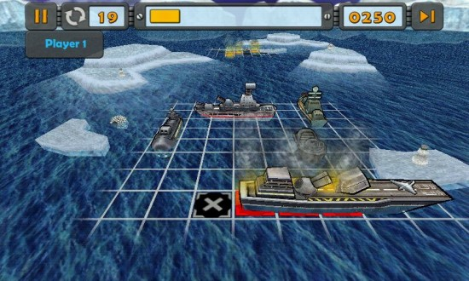
DESKTOPPROJECT
Place your screenshot here

Slide 6


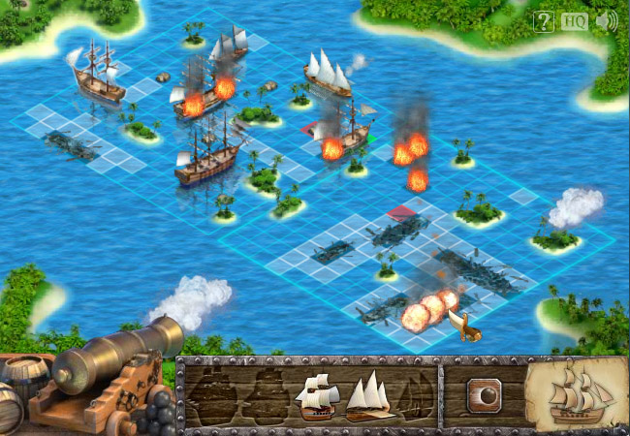
WEB PROJECT

Slide 7

BattleShip + Space

Slide 8


Dev Environment

Slide 9
Dev Schedule
~ Item Presentation | ~ 02.05 | ~ Final Presentation
Planning | UI & Graphics | Additional Function Implementation
 | Network | Improve Design & UI
 | Basic Game Logic | Refactoring & Optimizing

Slide 10



Our Goals
“Function”
“DESIGN”
“TeamWork”

Slide 11

Match Queue
Player 3
Player 2
Player 1

Slide 12
Match Queue

Slide 13
THANKS!
Any questions?

